Slide 1

Dhole Patil College of Engineering,Pune
Affiliated to Savitribai Phule Pune University
Approved by AICTE
Department Of Computer Engineering
A
Seminar
on
“Neuralink : The brain's magical future”
Presented By Under the guidance of
Anup Jagtap. Prof. Pratush Jadoun

Slide 2
CONTENT
01
02
03
04
05
06
Introduction
Future
Scope
Literature Review
Conclusion
Reference

Slide 3
Introduction to Neuralink
Neuralink is a pioneering neurotechnology
company focused on developing braincomputer
interfaces. This technology aims
to enable direct communication between
the human brain and machines,
potentially transforming how we interact
with technology and enhancing cognitive
functions.

Slide 4
Objective
Treat Neurological Disorders: One of the immediate objectives is to use brain implants to help treat conditions like paralysis, Alzheimer's, Parkinson's, and spinal cord injuries. The goal is to restore mobility, cognition, and communication in people affected by these conditions.
Enable Direct Brain-Computer Communication: Neuralink is working toward creating a seamless connection between the brain and external devices, allowing users to control computers, smartphones, or prosthetics using their thoughts.
Enhance Human Cognition: In the long term, Neuralink envisions augmenting human intelligence and memory, potentially enhancing cognitive functions beyond natural limits.
Facilitate Symbiosis with AI: Elon Musk has stated that Neuralink's ultimate goal is to help humanity achieve a symbiotic relationship with artificial intelligence. By integrating with AI, humans could keep pace with the rapid advancements in AI technology, potentially avoiding a scenario where AI surpasses human control.
Create Advanced Prosthetics and Robotics: Neuralink seeks to develop advanced neuroprosthetic devices that can be controlled with the brain, enabling more intuitive and natural interactions with artificial limbs or robotics.

Slide 5
Literature review
Research paper | Year | Author | Summary
The Internet of Brain Things: Theoretical Basis for the Usage of Neuralink Chip | 2023 | Huber Nieto-Chaupis | If the chip called Neuralink is realized and marketable then a wide spectrum of biomedical opportunities shall be available. One of them is the potential usage of chip as an implanted antenna.
Position: On potential malware&new attack vectors for Internet-of-Brains (IoB) | 2024 | 1st Tuomo Lahtinen 2nd Andrei Costin 3rd Guillermo Suarez-Tangil | The Internet of Brains (IoB) is a relatively recent and still emerging computing paradigm connecting different Brain-Computer Interface (BCI) devices to networks, smartphones, cloud, software, and machine-learning models.

Slide 6

What is Neuralink?
Neuralink's mission is to create highbandwidth
interfaces that connect the
brain to computers. By using thin threads
implanted in the brain, they aim to decode
neural signals, allowing for real-time
communication with devices and
improving human capabilities

Slide 7
The applications of Neuralink are vast, including medical treatments for neurological disorders, enhancing memory, and even enabling telepathic communication. This technology could revolutionize how we approach mental health and cognitive enhancement.

Slide 8
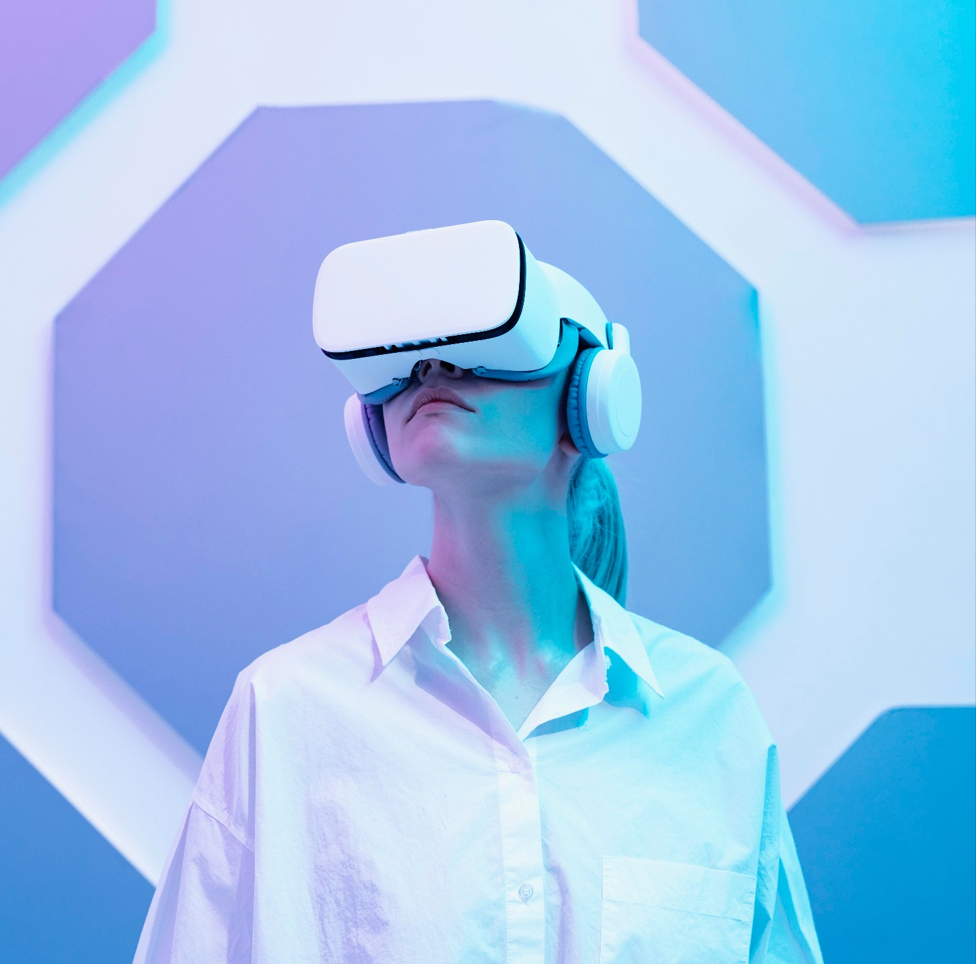
Future of Neuralink
The future of Neuralink holds immense
potential. As technology advances, we may
witness enhanced human capabilities,
improved quality of life, and new forms of
interaction with the digital world. The
possibilities are both exciting and
daunting.

Slide 9

Scope
Neuralink, founded by Elon Musk, is focused on developing brain-computer interface (BCI) technologies. The scope of Neuralink's work includes:
Medical Applications: Initially aimed at treating neurological conditions, such as Parkinson's disease, epilepsy, and spinal cord injuries. The goal is to restore motor function or enable communication for individuals with severe disabilities.
Enhanced Cognitive Abilities: In the long term, Neuralink envisions augmenting human cognitive capabilities, potentially allowing for improved memory, learning speeds, and even interfacing directly with digital devices.
Neuroscience Research: The technology could advance our understanding of the brain, offering insights into how neural processes work, which could have implications for both health and technology.
Interfacing with AI: A key part of Neuralink's vision is to create a symbiotic relationship between humans and AI, enhancing human decision-making and creativity.

Slide 10

Application
Medical Treatments:
Neurological Disorders: Could help manage conditions like Parkinson’s, epilepsy, and depression by stimulating specific brain areas.
1
2
Human-Machine Interaction:
Control Devices: Allow users to control computers, smartphones, and prosthetic limbs using thought.
3
Research:
Brain Function: Advance our understanding of the brain’s workings through real-time data collection and analysis.
4
Entertainment:
Gaming: Revolutionize gaming by providing direct brain control over characters and environments.
5
Mental Health:
Therapeutic Applications: Potentially offer new treatments for anxiety, PTSD, and other mental health conditions.

Slide 11
Conclusion
Neuralink represents a significant step
Towards human-machine integration.
While the benefits are promising, it is
essential to navigate the ethical landscape
carefully. The journey ahead will shape the
future of technology and humanity.

Slide 12

REFERENCE
Neuralink's Official Website
Books on BCIs
IEEE Research Papers
Wikipedia.com

Slide 13


ANY QUESTIONS

Slide 14
THANK YOU !
Thanks to everyone present here.

